Slide 1
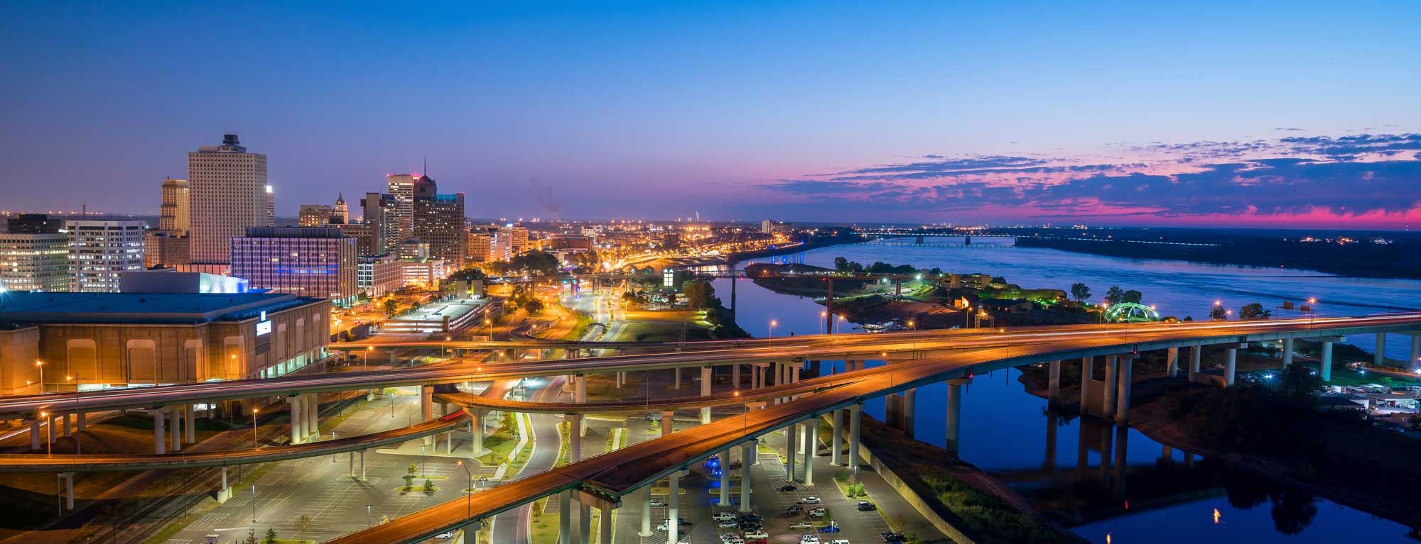


Memphis Public Service Corps Update
———
June 2021

Slide 2

Program Design
Notes:
DOUG – “So let’s step back and offer a little context of why we think this is good timing.”

Slide 3

Overview
The Memphis Public Service Corps (MPSC) offers part time employment opportunities to serve the community through various blight remediation efforts around Memphis. PSC targets opportunity youth and those with certain criminal backgrounds.
Notes:
KYLE

Slide 4
Eligibility
Age 18 or older
Pass background check
1 year participation (1 year extension eligible)
Notes:
KYLE

Slide 5
Crew Members
Status
Notes:
DOUG – “So let’s step back and offer a little context of why we think this is good timing.”

Slide 6
PSC Crew Member Status Update
 | FY20 | FY21
Onboarded | 25 | 19
Rolling Onboard Count | N/A | 42
Current Active P/T | N/A | 14
Resigned - Other CoM Opportunity | 0 | 7
MHU & WOWS Assistance
 | FY21
Employed via Program | 10
Driver’s License Reinstatement | 4
Notes:
KYLE

Slide 7
Performance
Notes:
DOUG – “So let’s step back and offer a little context of why we think this is good timing.”

Slide 8
Tasks include
Clearing: Litter, Tires, Brush, and Trash from Parks, Streets, Alleys, Rights-of-ways, Illegal dumps and Structures
Or…
  Power washing

Slide 9


Covid-19 Response
813 BOXES
102 BAGS
Litter
Food
During the height of the pandemic, corps members delivered boxes of food to residents and collected bags of litter (4/20/20 – 5/8/20)
Notes:
DOUG

Slide 10
Performance highlights
Collection Data
2020 - 2021 | Bags of Litter | Tires | Drains
11 May 20 – 25 Jun 21 | 19,615 | 13,804 | 630
* 07 May 21 – 25 Jun 21
Council District | # of Clean-Ups | Requests by City Council District
1 | 34 | 21
2 | 28 | 16
3 | 40 | 24
4 | 56 | 43
5 | 28 | 13
6 | 62 | 60
7 | 79 | 51
Notes:
KYLE

Slide 11
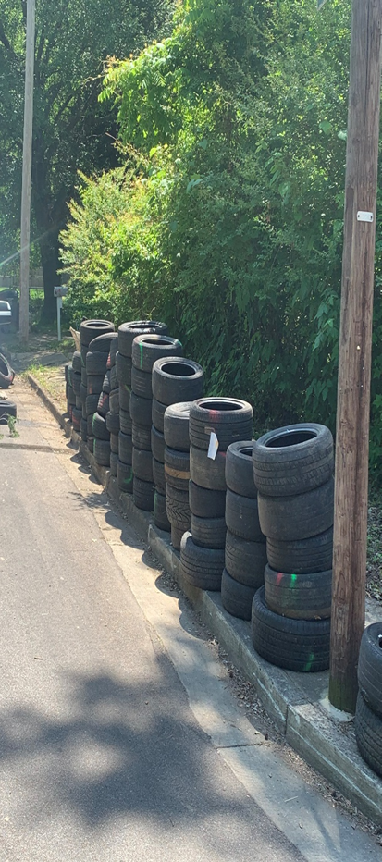
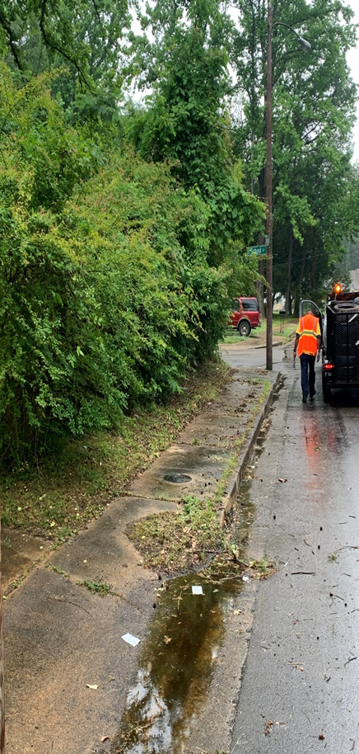
Before & after
June 22, 2021
Notes:
KYLE

Slide 12
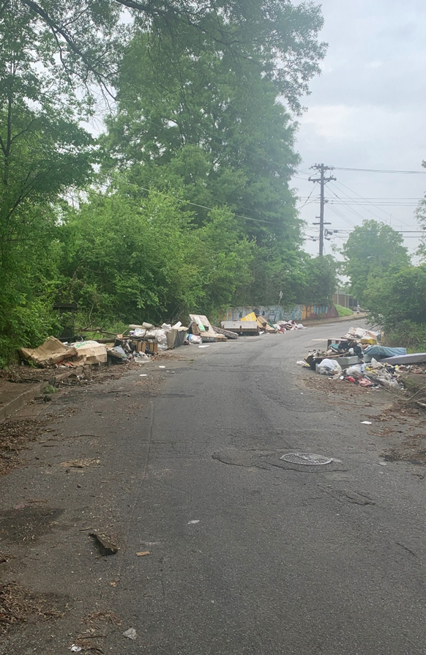
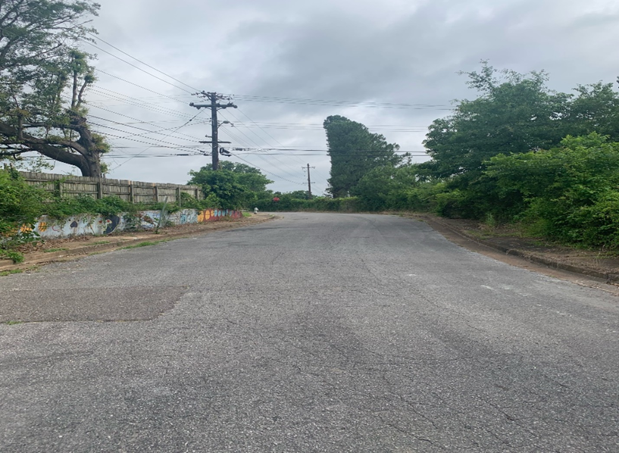
Before & after
June 22, 2021
Notes:
KYLE

Slide 13

Internal partnerships
Administration, Council members, Solid Waste, General Services, Grounds, Environmental Services, Environmental Enforcement, Street Maintenance, Parks
Notes:
DOUG – “So let’s step back and offer a little context of why we think this is good timing.”

Slide 14
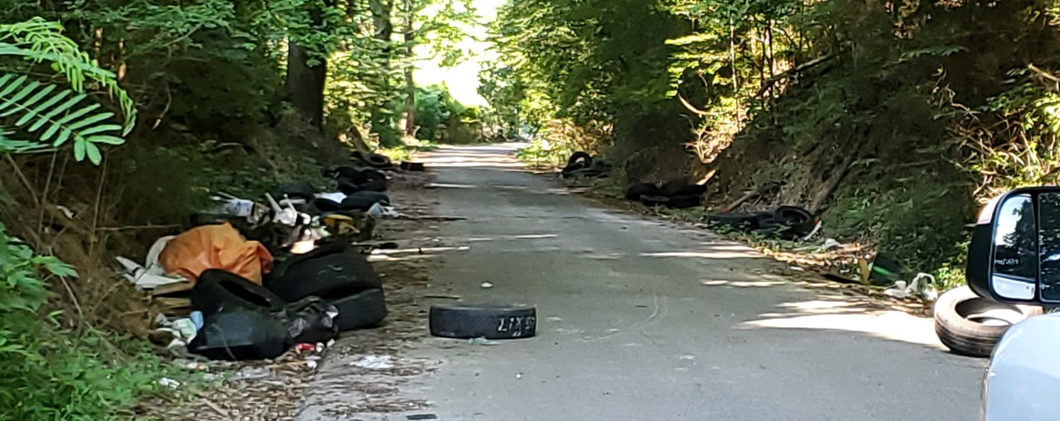
Questions
Memphis Public Service Corps Update
June 2021

